Slide 1
Database System (CS-103)
SQL Joins
Mr. Hamza Javed,
Department of Computer Science,
Muslim Youth University, Islamabad, Pakistan

Slide 2
Basic SQL Join Types
There are four basic types of SQL joins: inner, left, right, and full. The easiest and most intuitive way to explain the difference between these four types is by using a Venn diagram, which shows all possible logical relations between data sets.

Slide 3
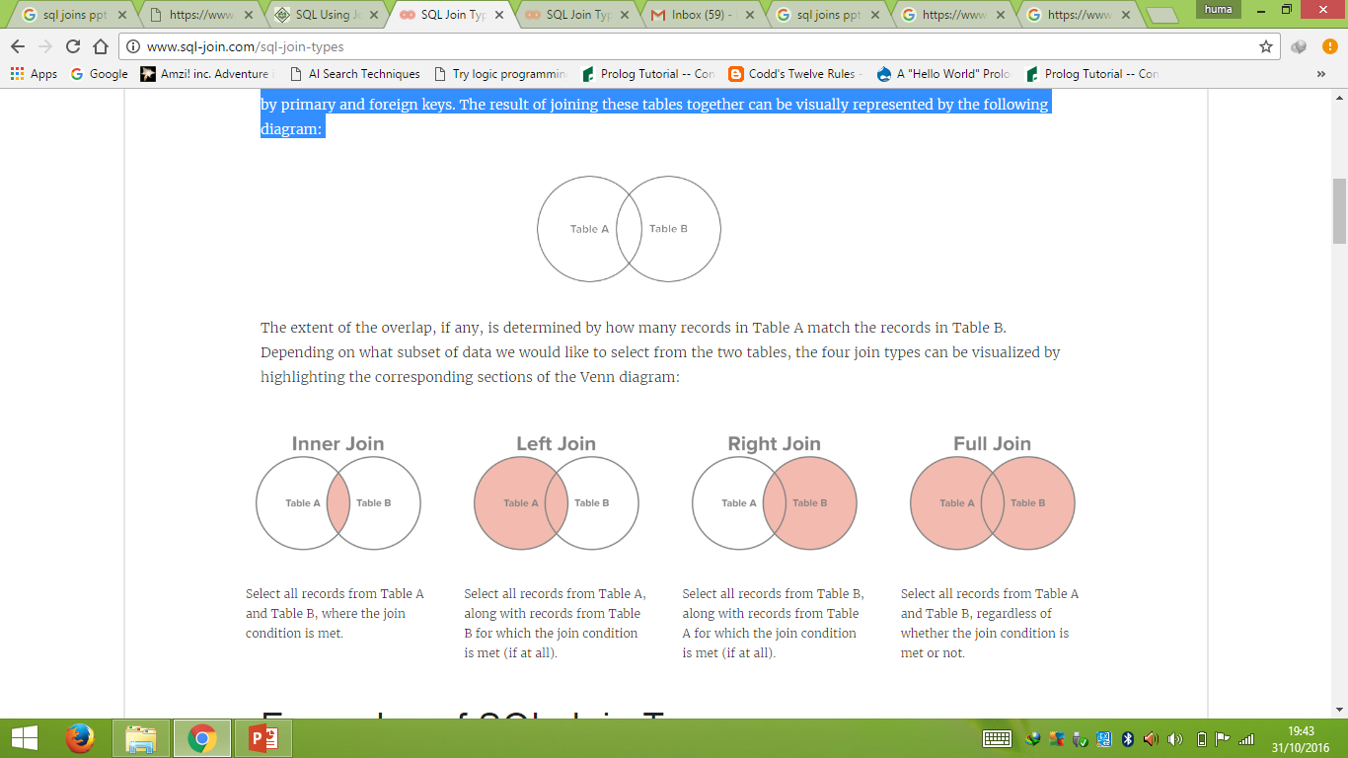
Basic SQL Join Types

Slide 4
SQL Join
Id | Name | Age | University
1 | Ali | 17 | Muslim Youth
2 | Arslan | 19 | FAST-NUCES
3 | Faizan | 20 | Air University
4 | Zara | 22 | Islamic university
UId | University
11 | Muslim Youth
12 | FAST-NUCES
13 | Air University
14 | Islamic university

Slide 5
SQL Joins
Id | Name | Age | University
1 | Ali | 17 | 11
2 | Arslan | 19 | 12
3 | Faizan | 20 | 13
4 | Zara | 22 | 14
UId | University
11 | Muslim Youth
12 | FAST-NUCES
13 | Air University
14 | Islamic university
Primary Key
Primary Key
Foreign Key
Notes:
Create table sectionb.university (UId int Not Null Auto_increment,UName varchar(255) Not Null,Primary Key(UId));
Create table sectionb.student (Id int Not Null Auto_increment,SName varchar(255) Not Null,Age int Not Null check(age>=18),Gender varchar(50) Not Null,Phone int Not Null UNIQUE,UName int Not Null,Primary Key(id),Foreign key (UName) references sectionb.university(UId));
INSERT INTO sectionb.university(UName) VALUES ('Muslim Youth'), ('FAST-NUCES'), ('Air University'), ('Islamic Univrsity’);
INSERT INTO sectionb.student(SName, Age, Gender, Phone, UName) VALUES ('Ali', 21, 'Male', 0033333, 1), ('Arslan', 19, 'Male', 0432333, 2), ('Faizan', 20, 'Male', 10340343, 3), ('Zara', 22, 'Female', 534344409, 4);

Slide 6
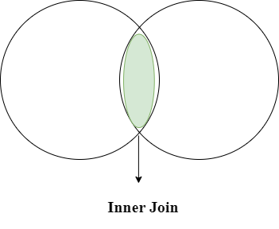
Inner Join
Inner Join select records that have matching values in both tables

Slide 7
Inner Join
Syntax:
Select columns from table1 inner join table2 ON table1.Column_Name = table2.Column_Name;
Example:
Select * from sectionb.student INNER JOIN sectionb.university ON student.UName = university.UId;
OR
Select s.Id, s.SName, s.Age, s.Gender, S.Phone, u.UName from sectionb.student s INNER JOIN sectionb.university u ON s.UName = u.UId;

Slide 8
Inner Join (where or order)
Syntax:
Select columns from table1 inner join table2 ON table1.Column_Name = table2.Column_Name;
Example:
Select s.Id, s.SName, s.Age, s.Gender, S.Phone, u.UName from sectionb.student s INNER JOIN sectionb.university u ON s.UName = u.UId where u.UName= 'Air university' order by s.SName;

Slide 9
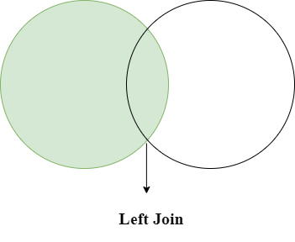
Left Joins

Slide 10
Left Joins
Id | Name | Age | University
1 | Ali | 17 | 11
2 | Arslan | 19 | 12
3 | Faizan | 20
4 | Zara | 22 | 14
UId | University
11 | Muslim Youth
12 | FAST-NUCES
13 | Air University
14 | Islamic university
Primary Key
Primary Key
Foreign Key
Notes:
Create table sectionb.university (UId int Not Null Auto_increment,UName varchar(255) Not Null,Primary Key(UId));
Create table sectionb.student (Id int Not Null Auto_increment,SName varchar(255) Not Null,Age int Not Null check(age>=18),Gender varchar(50) Not Null,Phone int Not Null UNIQUE,UName int Not Null,Primary Key(id),Foreign key (UName) references sectionb.university(UId));
INSERT INTO sectionb.university(UName) VALUES ('Muslim Youth'), ('FAST-NUCES'), ('Air University'), ('Islamic Univrsity’);
INSERT INTO sectionb.student(SName, Age, Gender, Phone, UName) VALUES ('Ali', 21, 'Male', 0033333, 1), ('Arslan', 19, 'Male', 0432333, 2), ('Faizan', 20, 'Male', 10340343, 3), ('Zara', 22, 'Female', 534344409, 4);

Slide 11
Left Joins
Syntax:
Select columns from table1 Left join table2 ON table1.Column_Name = table2.Column_Name;
Example:
Select * from sectionb.student Left JOIN sectionb.university ON student.UName = university.UId;

Slide 12
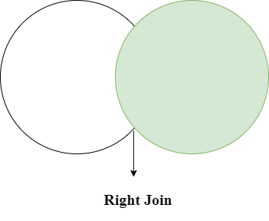
Right Joins

Slide 13
Right Joins
Syntax:
Select columns from table1 Right join table2 ON table1.Column_Name = table2.Column_Name;
Example:
Select * from sectionb.student Right JOIN sectionb.university ON student.UName = university.UId;

Slide 14
Cross Joins
Id | Name | Age | University
1 | Ali | 17 | 11
2 | Arslan | 19 | 12
3 | Faizan | 20 | 13
4 | Zara | 22 | 14
UId | University
11 | Muslim Youth
12 | FAST-NUCES
13 | Air University
14 | Islamic university
Primary Key
Primary Key
Foreign Key
Notes:
Create table sectionb.university (UId int Not Null Auto_increment,UName varchar(255) Not Null,Primary Key(UId));
Create table sectionb.student (Id int Not Null Auto_increment,SName varchar(255) Not Null,Age int Not Null check(age>=18),Gender varchar(50) Not Null,Phone int Not Null UNIQUE,UName int Not Null,Primary Key(id),Foreign key (UName) references sectionb.university(UId));
INSERT INTO sectionb.university(UName) VALUES ('Muslim Youth'), ('FAST-NUCES'), ('Air University'), ('Islamic Univrsity’);
INSERT INTO sectionb.student(SName, Age, Gender, Phone, UName) VALUES ('Ali', 21, 'Male', 0033333, 1), ('Arslan', 19, 'Male', 0432333, 2), ('Faizan', 20, 'Male', 10340343, 3), ('Zara', 22, 'Female', 534344409, 4);

Slide 15
Cross Join
Syntax:
Select columns from table1 Cross join table2
Example:
Select * from sectionb.student Cross JOIN sectionb.university;

Slide 16
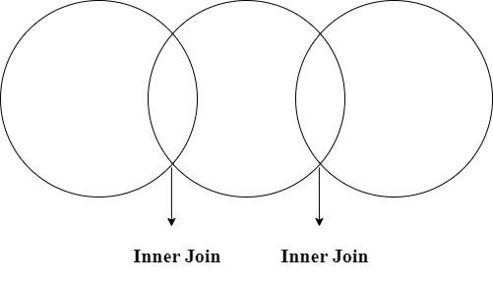
Multiple Joins

Slide 17
Cross Joins
Id | Name | Age | University
1 | Ali | 17 | 11
2 | Arslan | 19 | 12
3 | Faizan | 20 | 13
4 | Zara | 22 | 14
Degree
101
102
103
104
UId | University
11 | Muslim Youth
12 | FAST-NUCES
13 | Air University
14 | Islamic university
CId | Degree
101 | Computer Science
102 | BBA
103 | IR
104 | DPT
Primary Key
Primary Key
Foreign Key
Foreign Key
Primary Key
Notes:
Create table sectionb.university (UId int Not Null Auto_increment,UName varchar(255) Not Null,Primary Key(UId));
Create table sectionb.student (Id int Not Null Auto_increment,SName varchar(255) Not Null,Age int Not Null check(age>=18),Gender varchar(50) Not Null,Phone int Not Null UNIQUE,UName int Not Null,Primary Key(id),Foreign key (UName) references sectionb.university(UId));
INSERT INTO sectionb.university(UName) VALUES ('Muslim Youth'), ('FAST-NUCES'), ('Air University'), ('Islamic Univrsity’);
INSERT INTO sectionb.student(SName, Age, Gender, Phone, UName) VALUES ('Ali', 21, 'Male', 0033333, 1), ('Arslan', 19, 'Male', 0432333, 2), ('Faizan', 20, 'Male', 10340343, 3), ('Zara', 22, 'Female', 534344409, 4);

Slide 18
Multiple Joins
Syntax:
Select columns from table1 inner join table2 ON table1.Column_Name = table2.Column_Name inner join table3 ON table1.Column_Name = table3.Column_Name;
Example:
Select * from sectionb.student INNER JOIN sectionb.university ON student.UName = university.Uid INNER JOIN sectionb.course ON student.UName = university.Cid;

